Slide 1
Mixpanel Integration with Data Warehouses

Slide 2
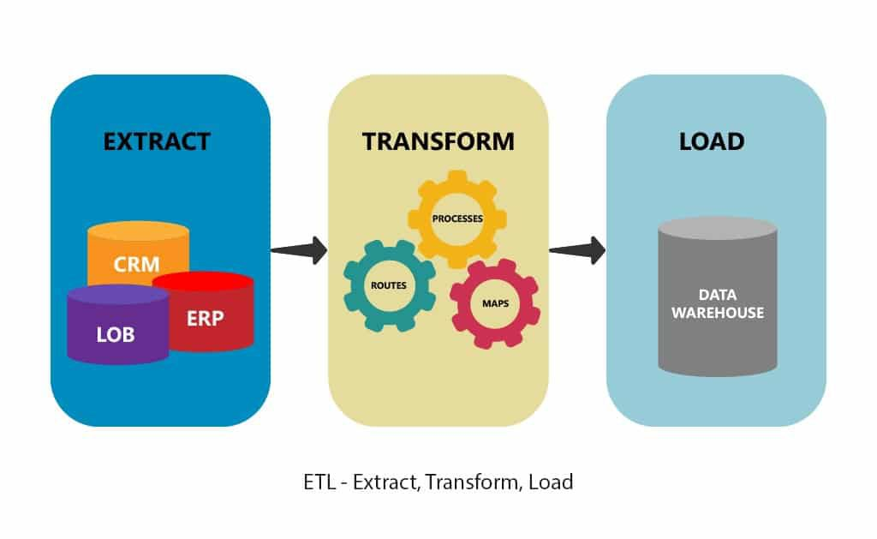
Prerequisites
Basic understanding of data warehouses and ETL (Extract, Transform, Load) processes
Access to Mixpanel account and API keys
Access to the data warehouse platform

Slide 3





Popular Data Warehouse Integrations with Mixpanel

Slide 4
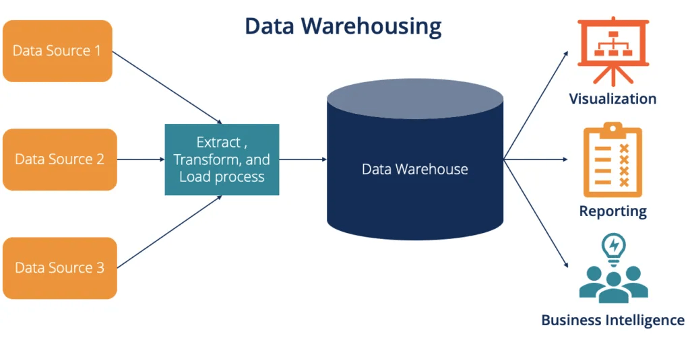
Benefits of Mixpanel Integration with Data Warehouse
Consolidation of data from multiple sources
Enhanced data analysis and reporting capabilities
Improved data quality and consistency
Scalable storage solutions

Slide 5




General Integration Steps
Step 1: Preparation
Identify Data Requirements
Determine the data that needs to be imported/exported
Choose ETL Tools (if applicable)

Slide 6
General Integration Steps cont.
Step 2: Access and Permissions
Common Permissions Needed:
{
"api_key": "YOUR_API_KEY",
"read_scope": true,
"write_scope": true,
"admin_scope": true
}

Slide 7
General Integration Steps cont.
Step 3: Configuration
Set Up Connections:
Between the data warehouse and Mixpanel
Schema Mapping
From the source to the destination
{
"warehouse_table": "mixpanel_events",
"columns": {
"event_name": "event",
"event_time": "timestamp",
"user_id": "distinct_id",
"properties": "properties" }}

Slide 8
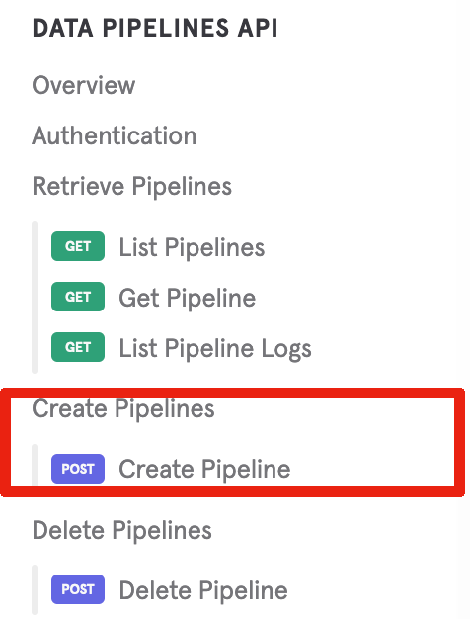
Exporting Data from Mixpanel
Overview:
Data Pipelines
Paid Add-On for Exporting Mixpanel Events to Cloud
Storage or Data Warehouses
Two-step Process:
Configuring the destination
Starting the export

Slide 9
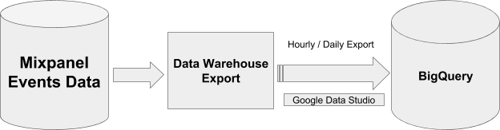
Exporting Data from Mixpanel cont.
Key Features:
Supports both Raw and Schematized Pipelines
Raw Pipelines export events as JSON files
Schematized Pipelines organize events into tables with schemas based on event history
Configuration
Raw Pipelines: Export events as JSON to a cloud storage bucket
Hourly exports: <BUCKET_NAME>/<PATH_PREFIX>/<MIXPANEL_PROJECT_ID>/<YEAR>/<MONTH>/<DAY>/<HOUR>
Daily exports: <BUCKET_NAME>/<PATH_PREFIX>/<MIXPANEL_PROJECT_ID>/<YEAR>/<MONTH>/<DAY>/full_day

Slide 10
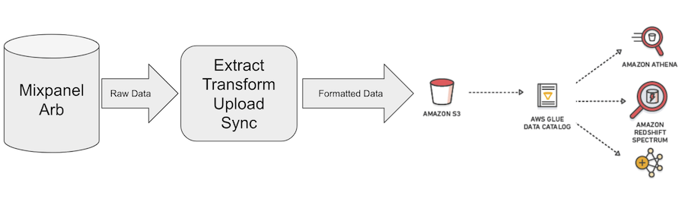
Exporting Data from Mixpanel cont.
Types of Schemas:
Monoschema
Stores all events in a single table
Event names and properties become columns
Multischema
Separate table for each event type
Columns represent properties specific to that event

Slide 11
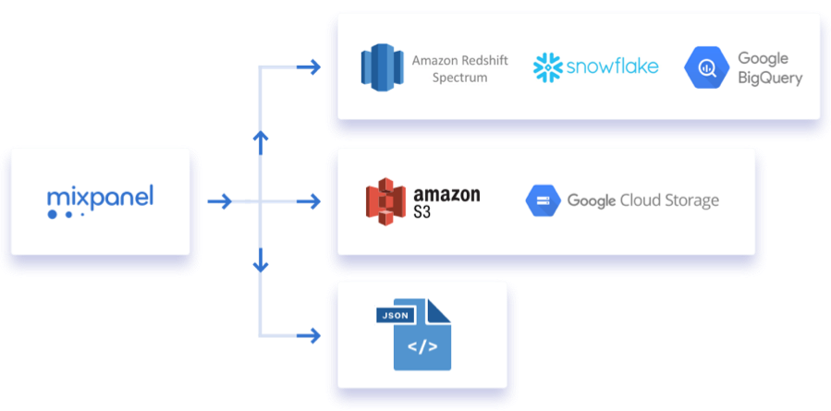
Exporting Data from Mixpanel cont.
Step 1: Configuring Your Destination
Raw Pipelines:
Export JSON events to cloud storage
Configuration guides available for:
Amazon S3
Google Cloud Storage
Azure Blob Storage
Schematized Pipelines:
Export events into schematized tables
Configuration guides available for:
BigQuery
Snowflake
AWS
Google Cloud Storage
Azure Blob Storage

Slide 12
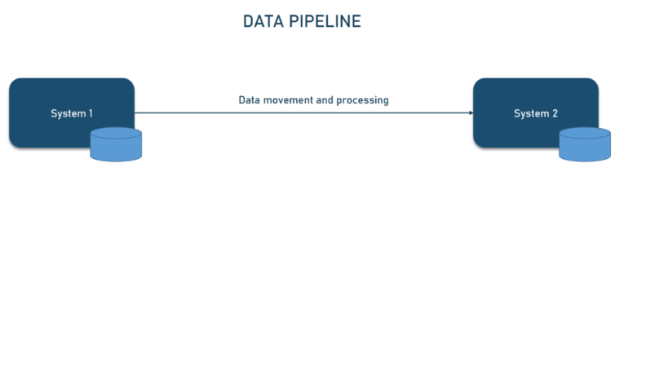
Exporting Data from Mixpanel cont.
Step 2: Creating the Pipeline
Create Pipeline API:
Initiates data export to configured destination
Trial limitations: daily scheduling, no data sync
Data Sync and Backfilling:
Data Sync: Maintains consistency between Mixpanel and destination warehouse
Backfilling: Exports historical data (up to 6 months back) with a specified from_date
User Data Support:
Export user data to a single table (mp_people_data)
For projects with ID merge, use the identity mapping table to resolve user identifiers

Slide 13
Exporting Data from Mixpanel cont.
Pipeline Creation:
Use the Create Pipeline API
Supports up to two recurring pipelines and one non-recurring pipeline per project
Date limits: from_date must be within 6 months of pipeline creation
Limits:
Maximum of 10K unique properties in schema
Projects exceeding this limit will have pipelines paused

Slide 14

Exporting Data from Mixpanel cont.
Transformation Rules:
Special characters and whitespaces in table/column names are replaced with underscores
Property names are converted to lowercase
Maximum name length is 128 characters
Properties with special characters or reserved keywords are prefixed (e.g., $ becomes mp_, reserved keywords become res_)

Slide 15
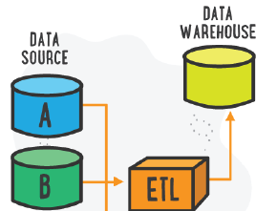
Importing Data to Mixpanel
Data Source Identification
Identify the source data in the data warehouse that needs to be imported to Mixpanel.
Data Extraction
Use any ETL tools to extract the required data from the data warehouse.
Data Transformation
Transform the data to match Mixpanel’s schema requirements.
Data Loading into Mixpanel
Use Mixpanel APIs or other supported methods to load the transformed data into Mixpanel.

Slide 16
Importing Data to Mixpanel cont.
Example Code Snippet for Data Loading into Mixpanel:
import requests
import json
api_key = 'YOUR_API_KEY’
data = {
'event': 'your_event_name',
'properties': {
'distinct_id': 'user_id',
'token': api_key,
'property1': 'value1',
'property2': 'value2'
}
}
response = requests.post(
'https://api.mixpanel.com/track/',
data=json.dumps(data),
headers={'Content-Type': 'application/json'}
)
print(response.status_code, response.text)

Slide 17
Best Practices
Regular Data Syncs: Schedule regular data syncs to keep Mixpanel data up-to-date with the data warehouse.
Monitoring and Alerts: Implement monitoring and alerts to track data transfer processes and handle errors promptly.
Data Governance: Ensure data governance policies are in place to maintain data quality and compliance.

Slide 18
Useful Links:
Mixpanel Developer Documentation:
https://docs.mixpanel.com/docs/getting-started/what-is-mixpanel
Identifying Users:
https://docs.mixpanel.com/docs/tracking/how-tos/identifying-users
Using Javascript Identify:
https://docs.mixpanel.com/docs/tracking/reference/javascript#setting-profile-properties
Reserved Events Properties:
https://docs.mixpanel.com/docs/tracking/how-tos/events-and-properties#reserved-event-properties

